Slide 1

PART 5.3
Types of Machine Learning
A categorized overview of the main learning paradigms.

Slide 2
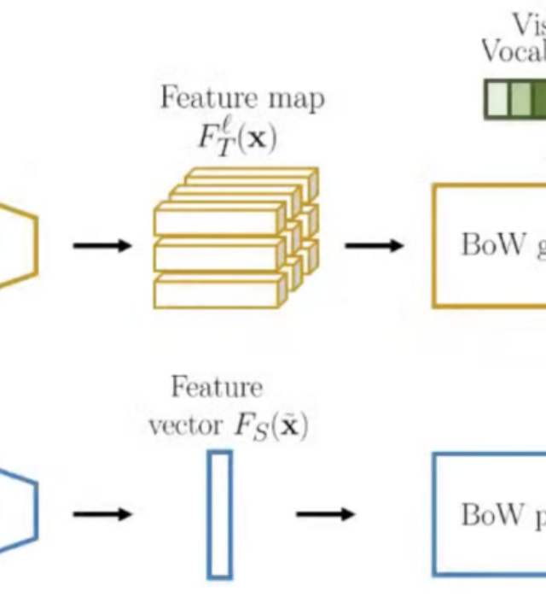
5.3.1 Supervised Learning
Definition: The algorithm learns from labeled training data, where each example includes both input features and the correct output (target value).
Training data consists of (input, output) pairs.
The model learns to map inputs to outputs.
Goal: Make accurate predictions on new, unseen data.

Slide 3

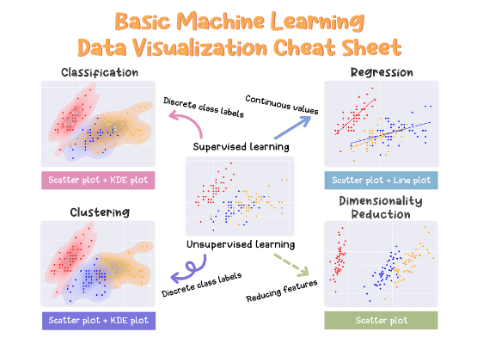
Problem Type A: Classification
Predicting Discrete Categories
Binary Classification: Two possible outcomes.
(e.g., Spam/Not Spam, Disease/No Disease)
Multiclass Classification: Multiple distinct categories.
(e.g., Digit recognition 0-9, Animal species)
Common Examples:
Medical diagnosis
Image classification
Sentiment analysis

Slide 4
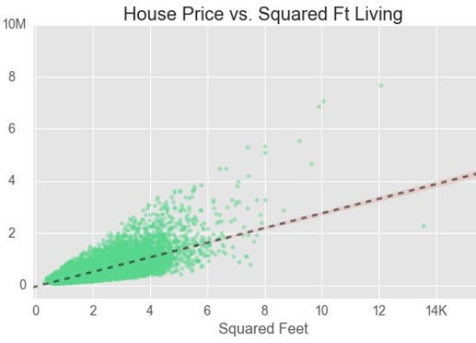
Problem Type B: Regression
Predicting Continuous Values
Unlike classification, regression models predict numerical values that can fall anywhere within a continuous range.
House price prediction
Stock price forecasting
Temperature prediction
Sales forecasting

Slide 5



Common Supervised Algorithms
Linear Models
Tree-Based
Complex Models
•
Linear Regression
•
Decision Trees
•
Support Vector Machines (SVM)
•
Logistic Regression
•
Random Forests
•
Neural Networks
•
K-Nearest Neighbors (KNN)

Slide 6
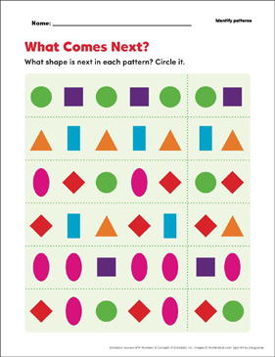
5.3.2 Unsupervised Learning
Definition: The algorithm learns patterns from unlabeled data without explicit target outputs. The system discovers hidden structures and relationships on its own.
Only input data is provided (no labels).
The model identifies patterns or groupings.
Goal: Discover inherent organization in the data.

Slide 7
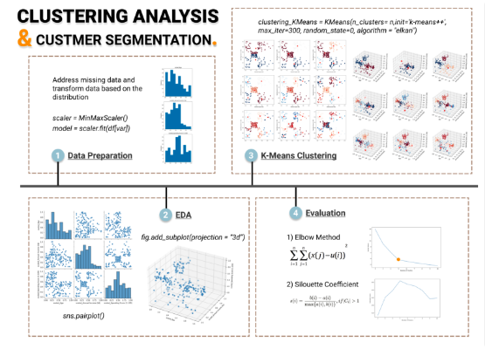
Problem Type A: Clustering
Grouping Similar Data
Clustering algorithms organize unlabelled data points into groups (clusters) where items in the same group are more similar to each other than to those in other groups.
Customer segmentation for marketing
Document organization
Gene sequence analysis
Image compression

Slide 8


Dimensionality & Anomalies
Dimensionality Reduction
Anomaly Detection
Reducing the number of features while preserving important information.
Identifying unusual patterns or outliers that do not conform to expected behavior.
•
Data visualization
•
Fraud detection
•
Feature extraction
•
Network intrusion detection
•
Noise reduction
•
Manufacturing defect detection
•
Computational efficiency

Slide 9



Common Unsupervised Algorithms
Clustering
Dim. Reduction
Outlier Detection
•
K-Means Clustering
•
Principal Component Analysis (PCA)
•
Isolation Forests
•
Hierarchical Clustering
•
One-Class SVM
•
DBSCAN
•
t-SNE
•
Gaussian Mixture Models
•
Autoencoders

Slide 10
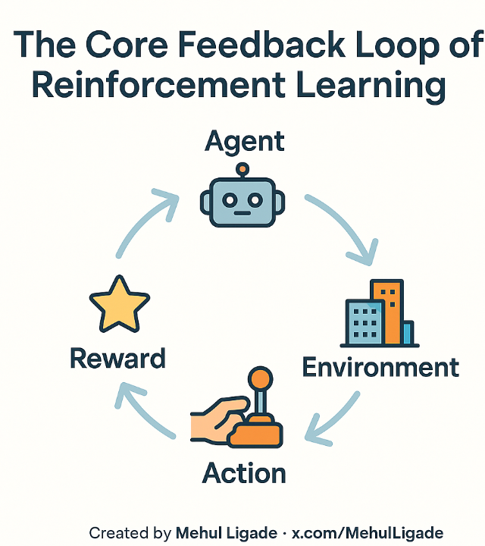
5.3.3 Reinforcement Learning
Definition: An agent learns to make decisions by interacting with an environment, receiving rewards or penalties based on its actions.
Agent takes actions in an environment.
Receives feedback (Reward/Penalty).
Learns to maximize cumulative reward.
Goal: Discover optimal strategy (policy).

Slide 11

Key Components & Examples
The Learning Loop
•
Agent: The learner/decision maker.
Applications
•
Environment: The world the agent interacts with.
•
Game playing (Chess, Go)
•
State: Current situation of the agent.
•
Robotics & autonomous navigation
•
Action: Choices available to the agent.
•
Resource allocation
•
Reward: Feedback signal indicating success.
•
Traffic signal control

Slide 12
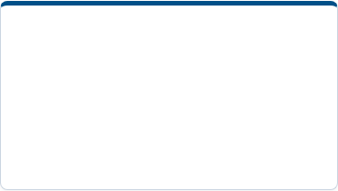
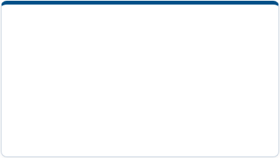

Common RL Algorithms
Value-Based
Policy-Based
Advanced Systems
•
Q-Learning
•
Policy Gradient Methods
•
AlphaGo
•
Deep Q-Networks (DQN)
•
Actor-Critic Methods
•
AlphaZero

Slide 13
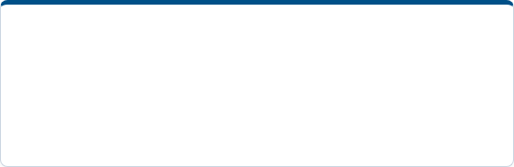
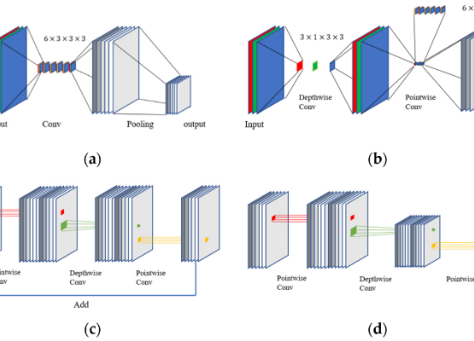
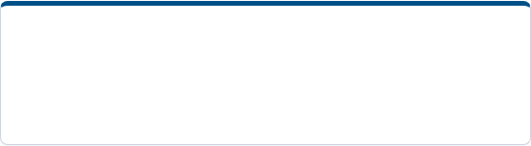

5.3.4 Other Learning Paradigms
Semi-Supervised Learning
Combines a small amount of labeled data with large amounts of unlabeled data. Useful when labeling is expensive.
Self-Supervised Learning
Creates labels from the data itself (e.g., predicting the next word in a sentence).
Transfer Learning
Applying knowledge learned from one task to a different but related task.

Slide 14






Image Sources
https://miro.medium.com/0*d23sAIFGW7bkGMTI.png
Source: medium.com
https://miro.medium.com/v2/resize:fit:2000/1*g1SoX7Hbh6vEdRGyQgcf7A.png
Source: medium.com
https://miro.medium.com/1*Zm2Hu724W6UQCVWWQe7afg.jpeg
Source: datalesdatales.medium.com
x-raw-image:///42fb95d4bf5f97aafb564ea14dc00a62ae7c6b90e984e94ac4f7d587e67b4d15
Source: www.microsoft.com
https://towardsdatascience.com/wp-content/uploads/2021/07/1xCKGM7tUzoR53oFv4yTPWA.png
Source: towardsdatascience.com
https://miro.medium.com/v2/resize:fit:1400/0*AMgCGArY675Kt1qG
Source: pub.towardsai.net

Slide 15

Image Sources
https://www.mdpi.com/sensors/sensors-22-01624/article_deploy/html/images/sensors-22-01624-g001.png
Source: www.mdpi.com

